Slide 1

LLM Engineering
MASTER AI & LARGE LANGUAGE MODELS

Slide 2

TODAY
UIs for non-frontend people!
What you can already do
Overview of transformers and the leading Frontier LLMs
Confidently use the OpenAI API including streaming with markdown and JSON generation
Use Frontier APIs
Today you will be able to
Describe Gradio, the remarkable platform for data science UIs
Create a simple UI using Gradio
Hook up Gradio to Frontier models

Slide 3
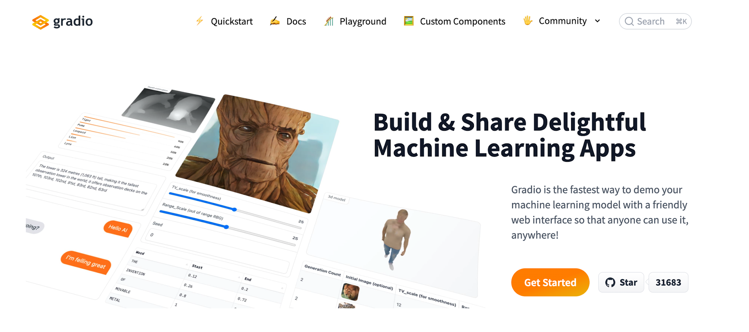
Introducing Gradio from Hugging Face

Slide 4
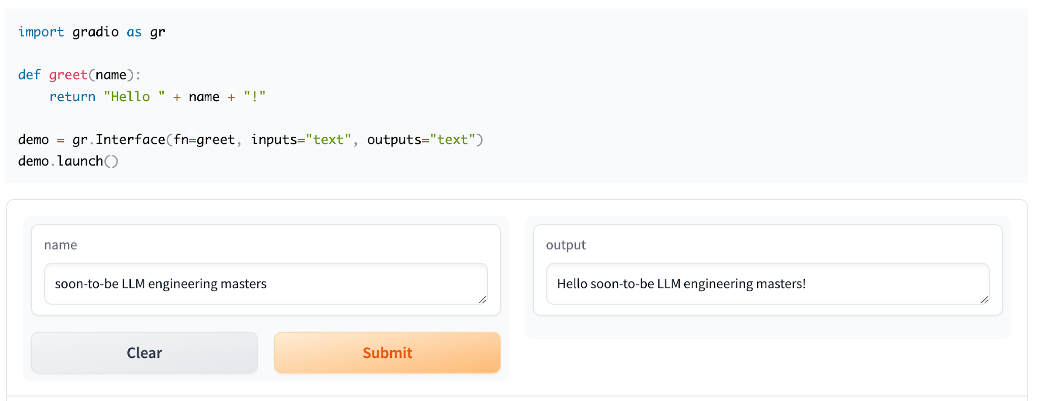
When I said it was easy..

Slide 5
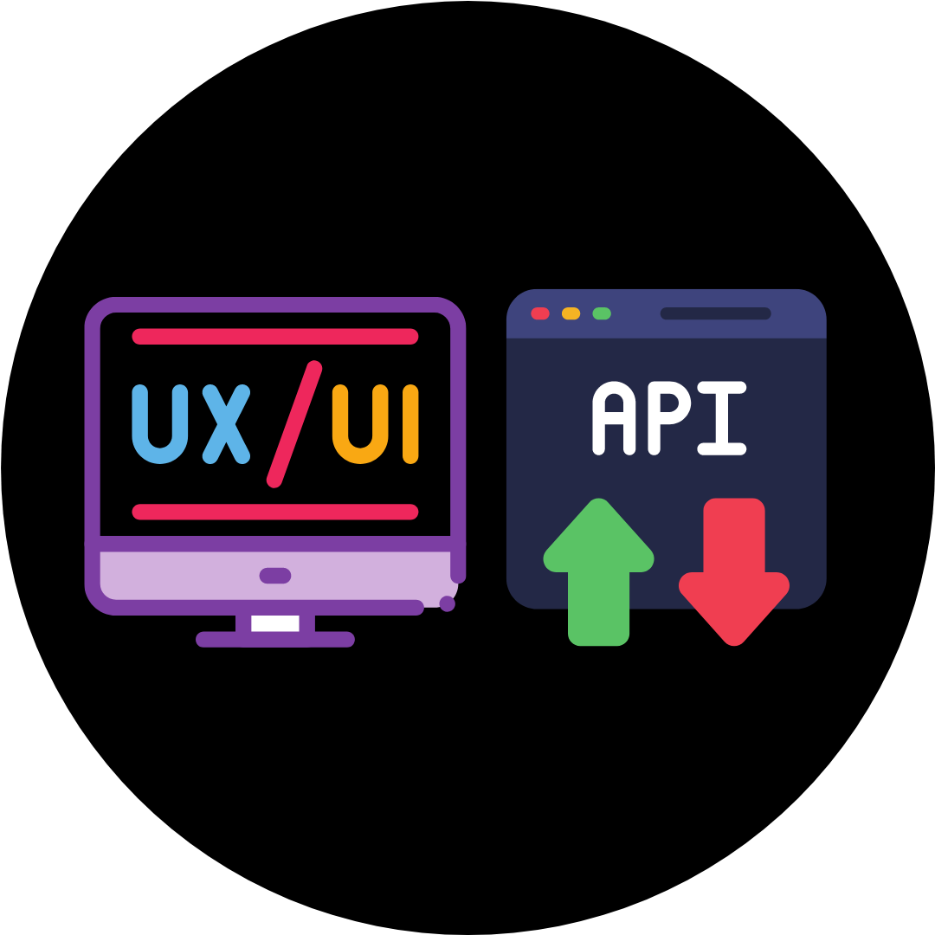


And now we will:
Create a UI for API calls to Frontier Models
Create a UI for the Company Brochure from Week 1
Include Streaming and Markdown

Slide 6
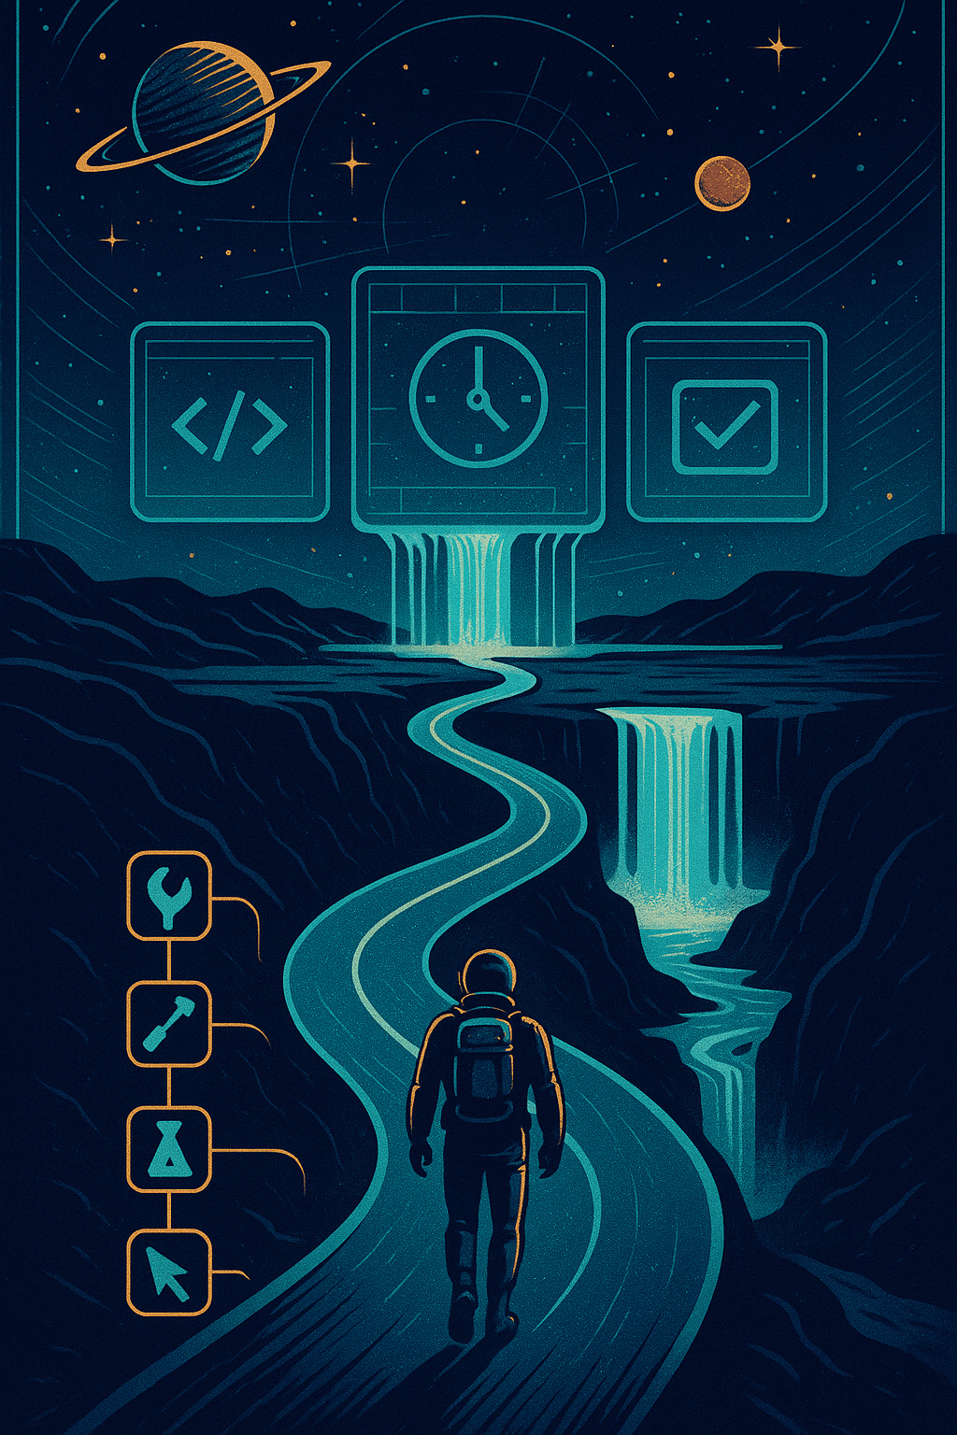
PROGRESS
You have leveled up again
What you can already do
Confidently use the OpenAI API including streaming with markdown and JSON generation
Use Frontier APIs
Build UIs for your solutions
Tomorrow you will be able to
Create a Chat UI in Gradio
Provide context in a prompt including multi-shot prompting
Build your first customer support AI assistant

